Slide 1
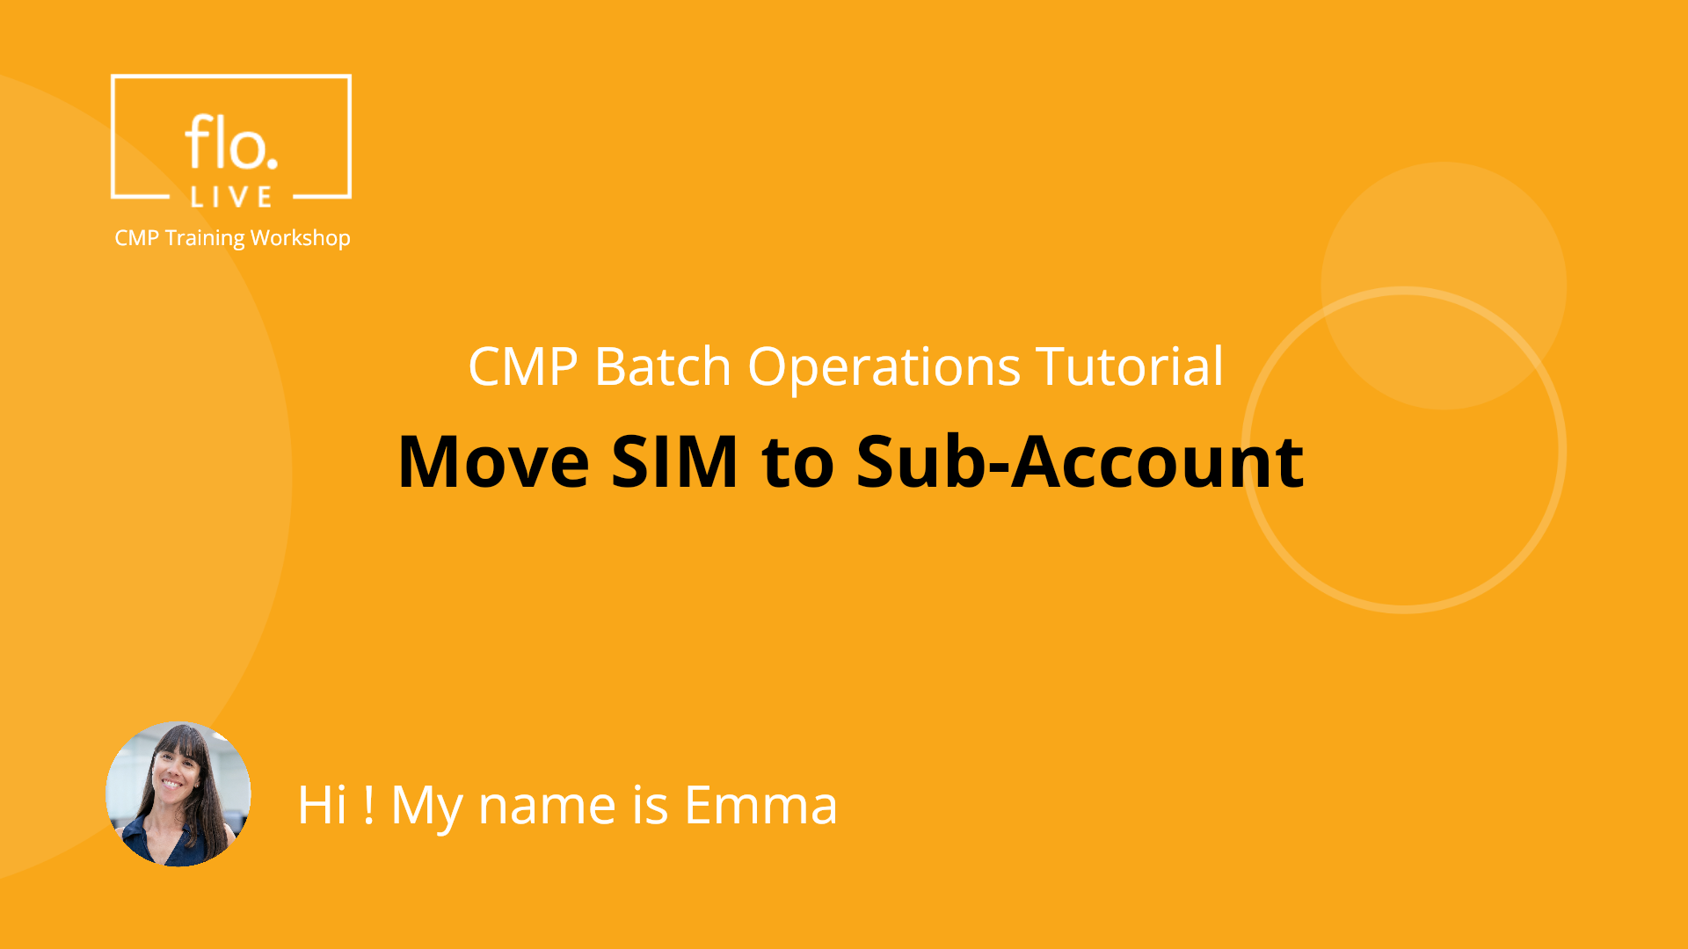
Notes:
Hi, My name is Emma and welcome to the CMP Batch Operations training tutorial.

Slide 2
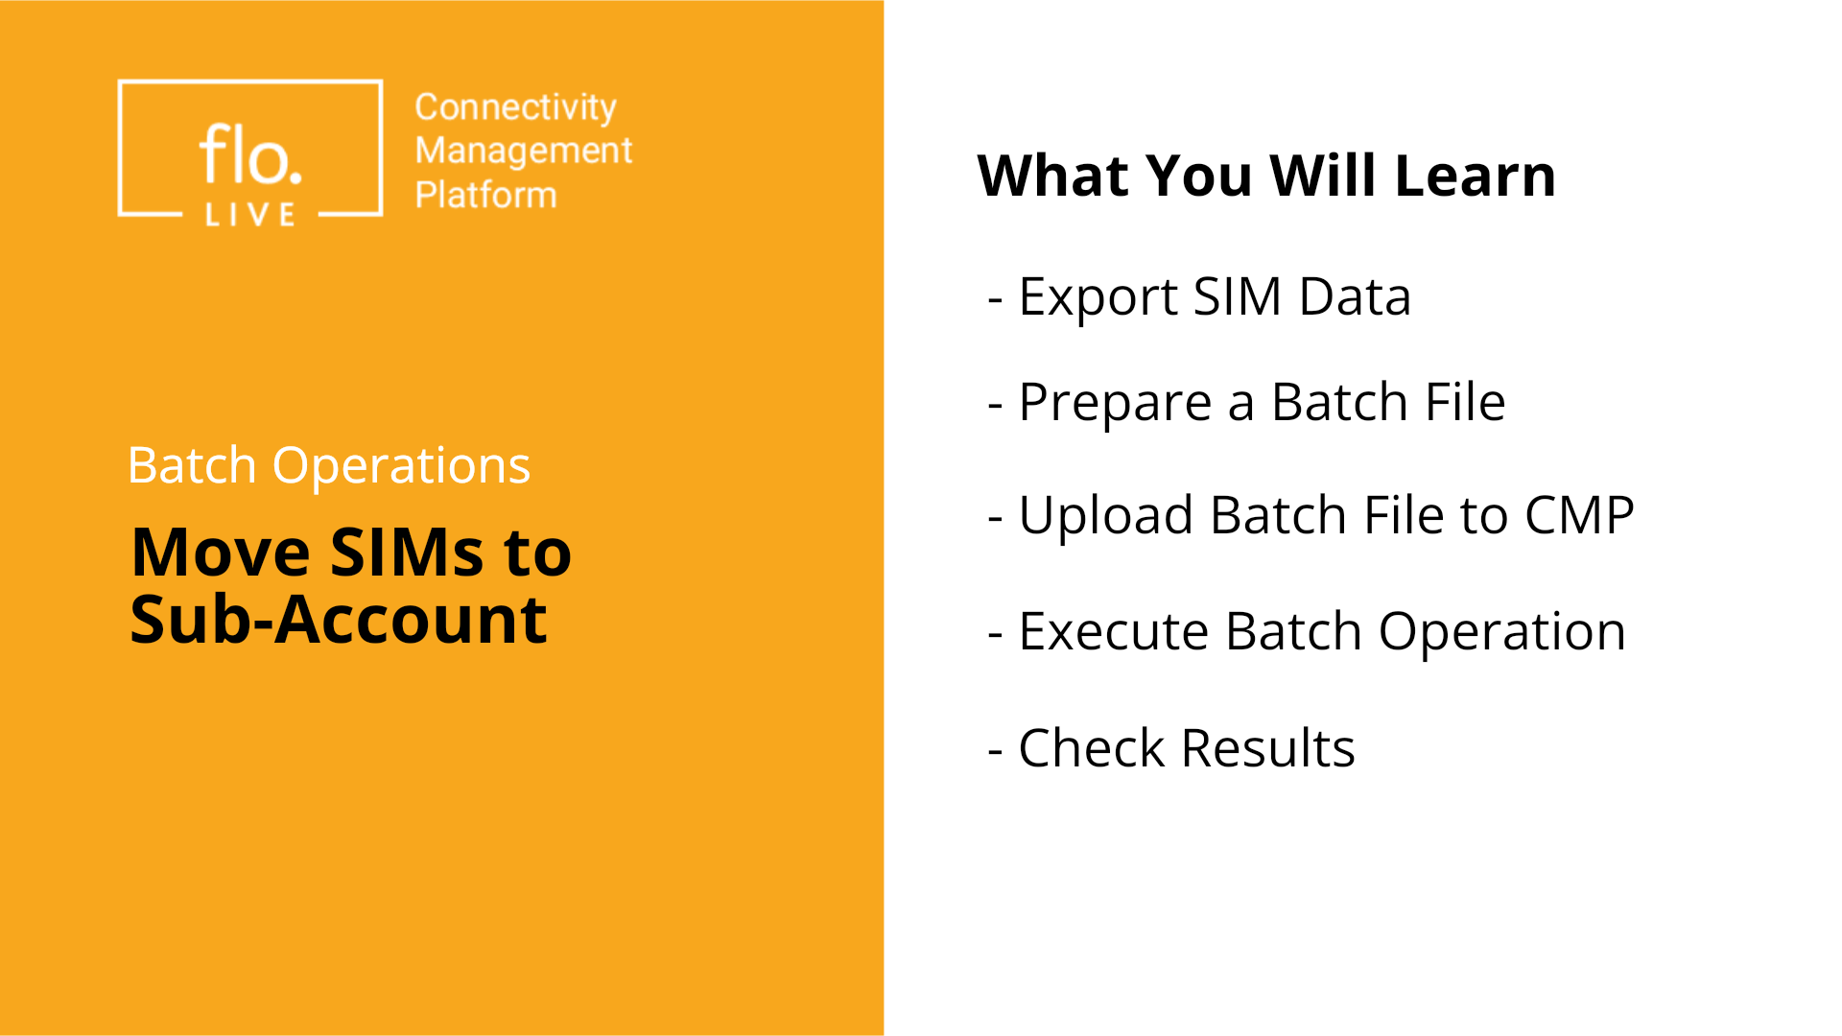
Notes:
This tutorial shows you how to move SIMs from one account to a sub-account using a single batch operation. In this five-step process you will learn how to export SIM data, prepare a batch file, upload it to the CMP, execute the operation, and check the batch operation results. Let’s begin

Slide 3
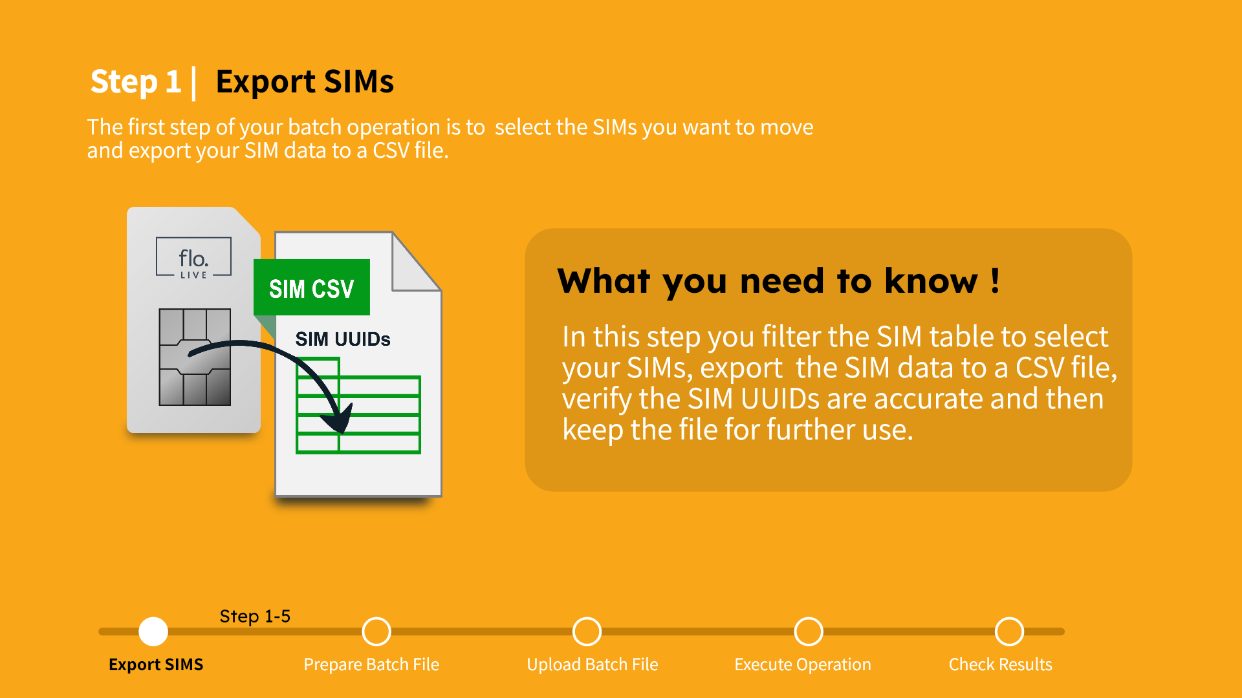
Notes:
The first step of your batch operation is to select the SIMs you want to move and then export your SIM data to a CSV file. This file thcontains the identifiers of the selected SIMs. The SIM CSV file is important because it serves as the basis for your batch operation.

Slide 4
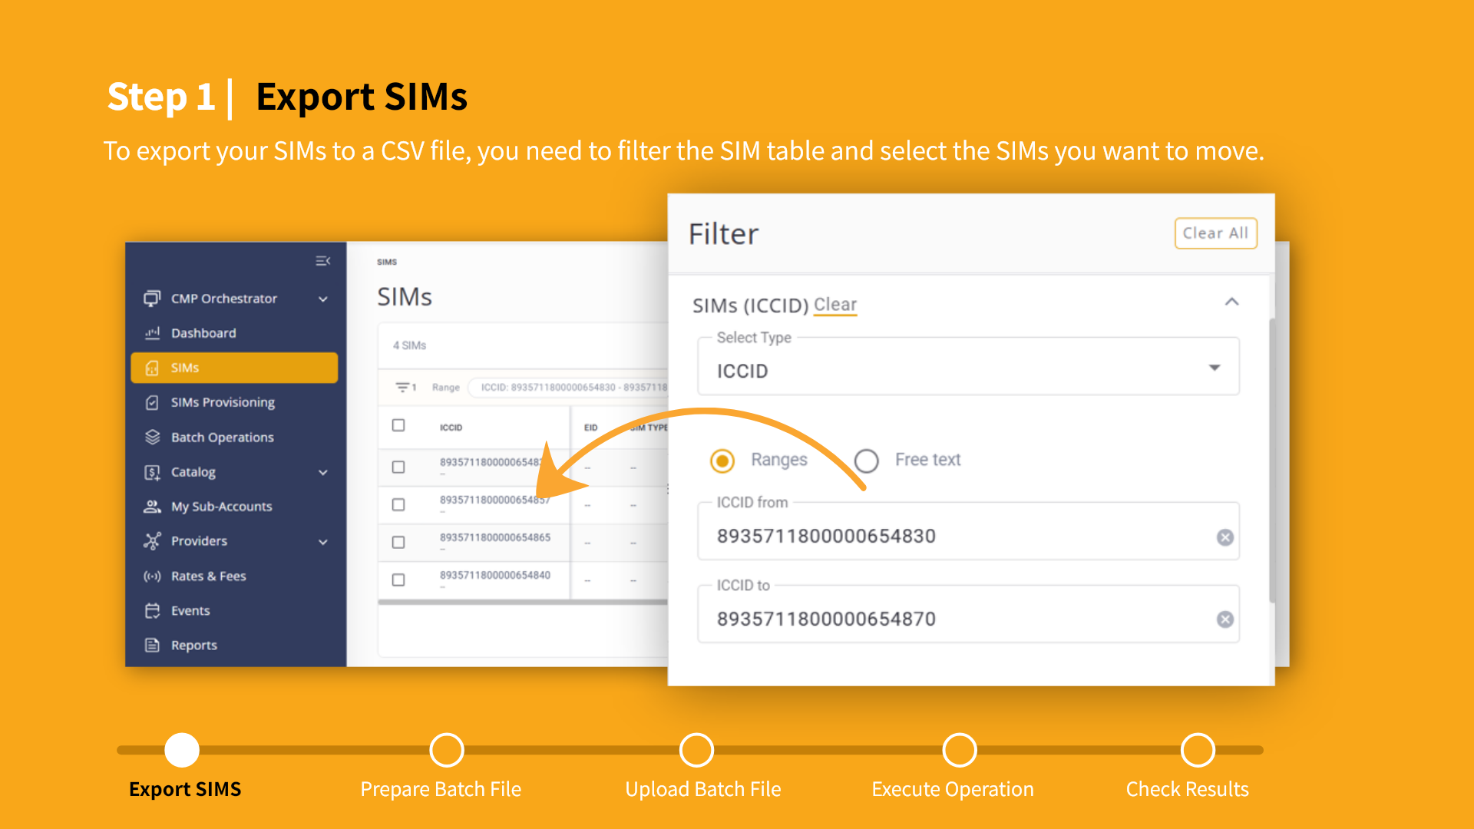
Notes:
To select the SIMs you want to move, navigate to the SIMs table in the CMP. Now apply filters to select the exact SIMs you want to move. In this example, we filter the SIM table by the ICCID range, however you can choose any other criteria. You should note, that accurate filtering is critical in order to avoid moving the wrong SIMs.

Slide 5
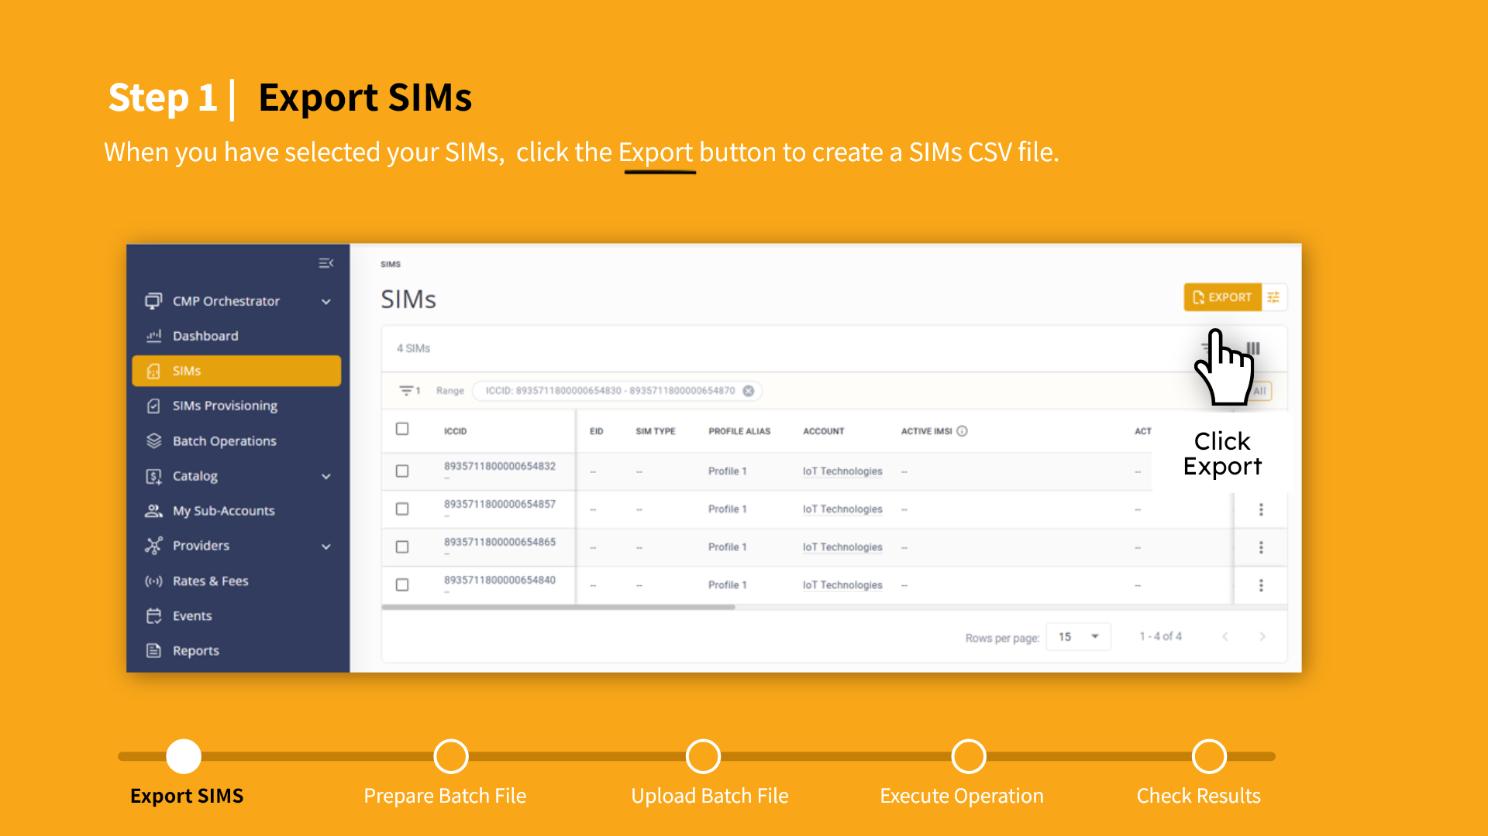
Notes:
When you have selected the relevant SIMs click the Export button. This generates a CSV file containing the required SIM UUID identifiers. Make sure your SIM selection is correct before you export to a file.

Slide 6
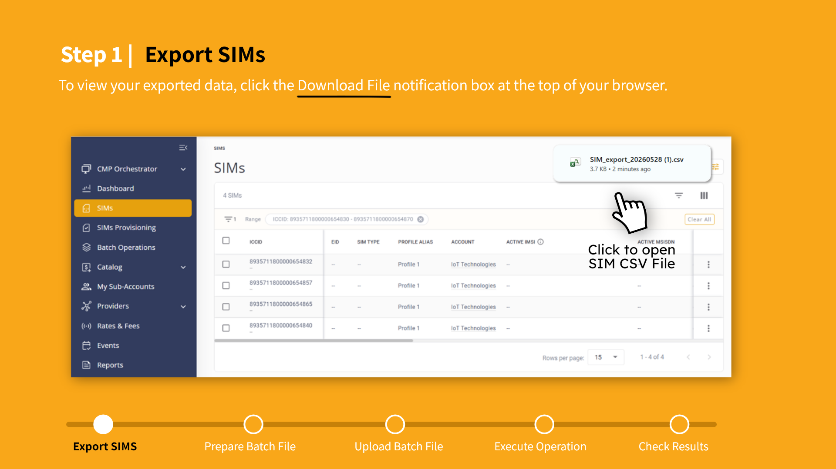
Notes:
You can download the SIM CSV file directly from your browser. You will need to open this file and verify that the correct SIMs were exported.

Slide 7
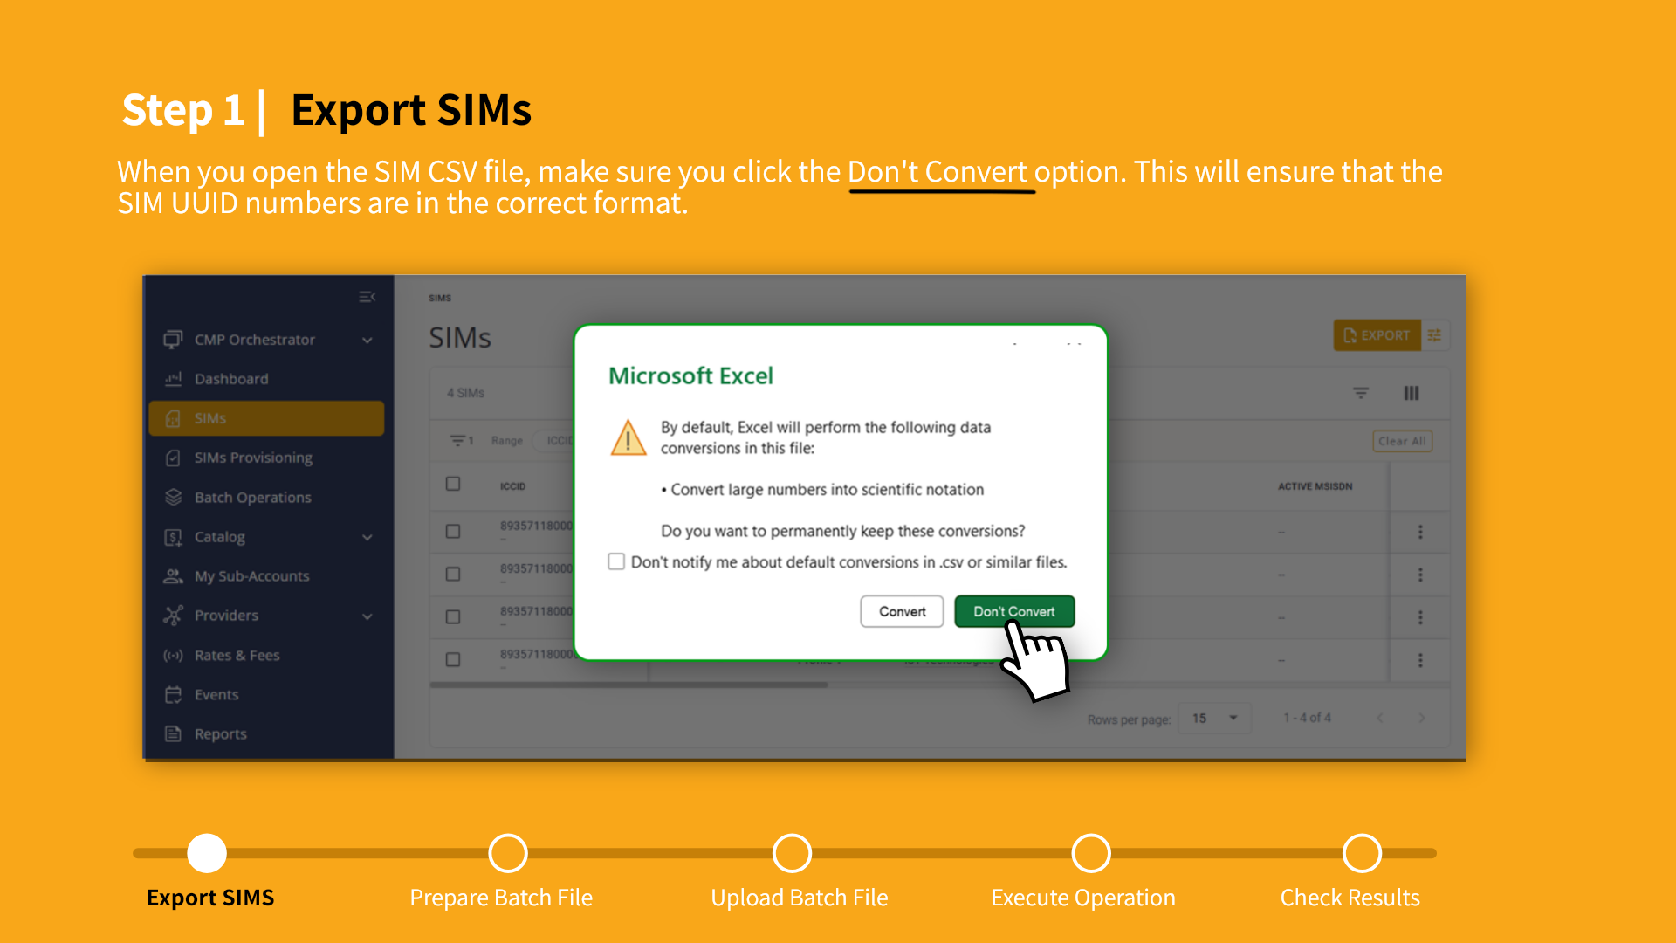
Notes:
When you open the CSV in Excel, make sure you choose the “Don’t Convert” option. This is important because it prevents the corruption of UUID data when you open the file in Excel. Maintaining the correct UUID format is essential for batch processing of your SIMs.

Slide 8
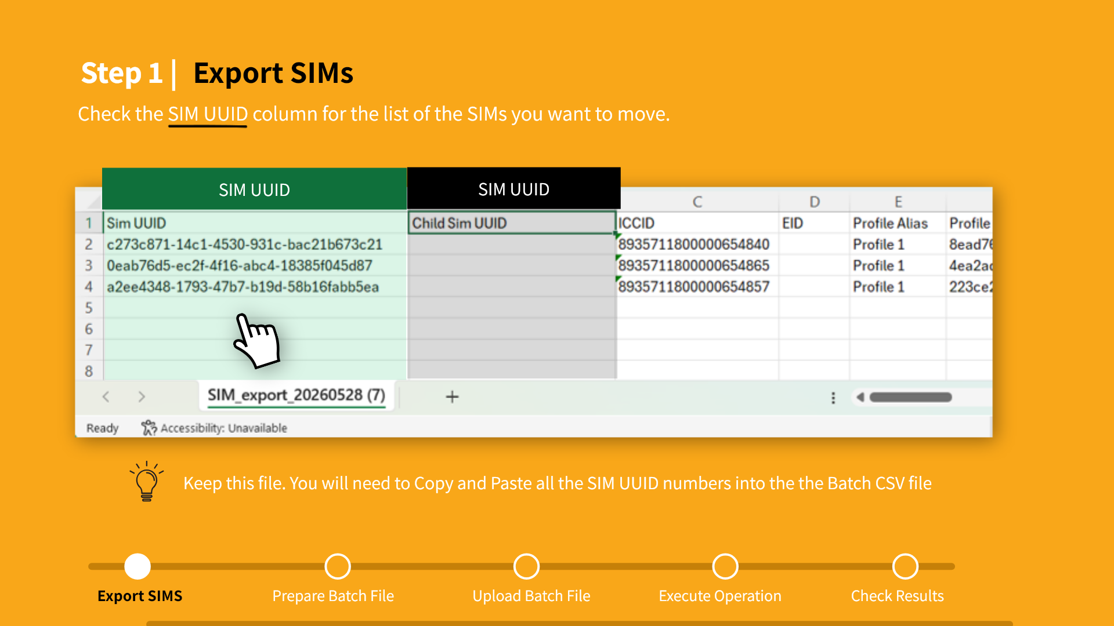
Notes:
Now open the SIM CSV file and verify that the SIM UUID column contains all the selected SIMs. Note that the Child SIM UUID column is empty and should not contain any data. Make sure you save the SIM CSV file because you will need to copy all the SIM UUIDs into your batch file.

Slide 9
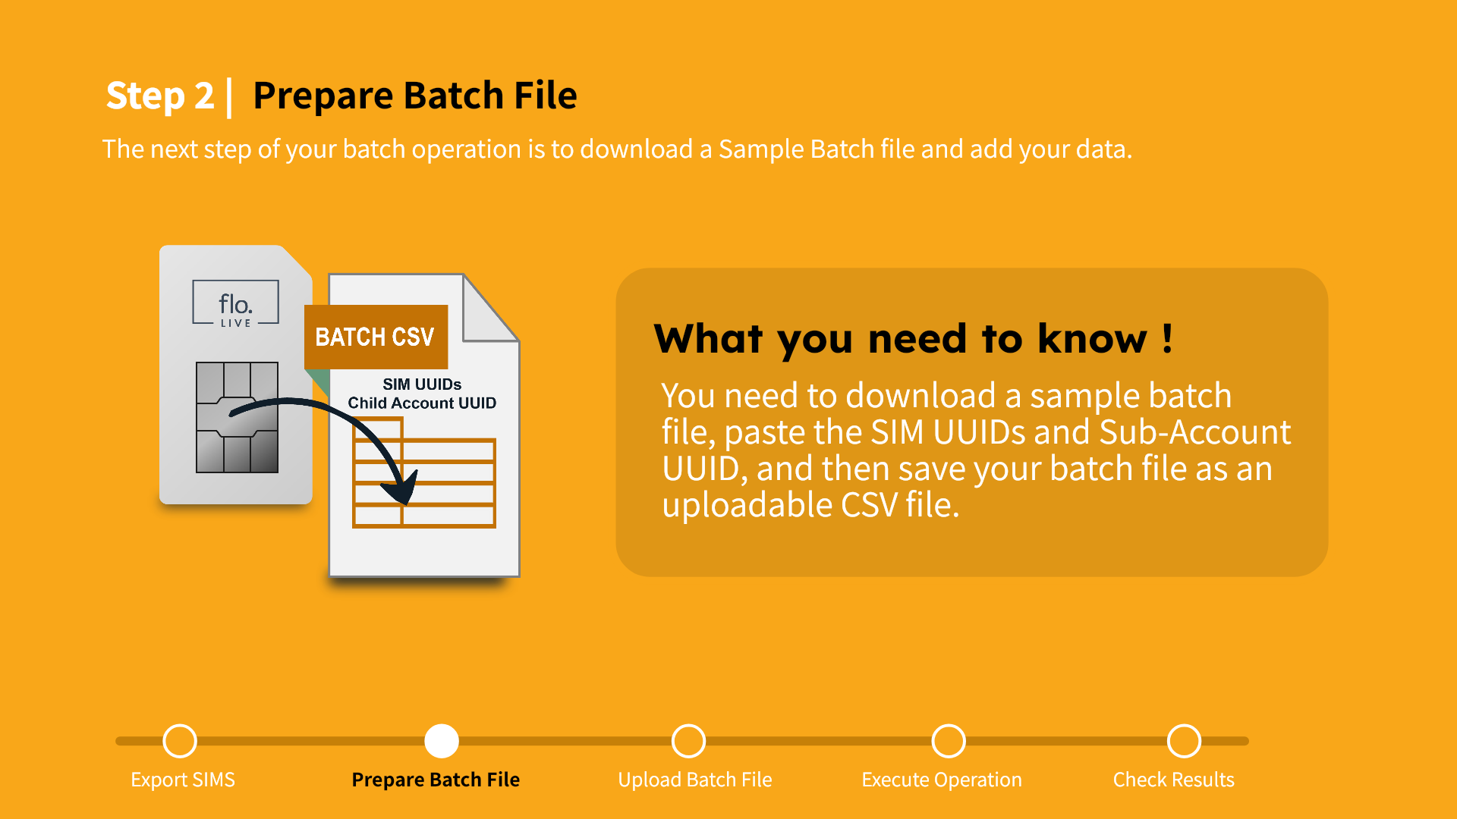
Notes:
After exporting your SIM data, the next step is to prepare your Batch CSV file. To do this, you will need to download a sample file from the Batch Operations module, then paste the SIM UUIDs and Sub-account UUIDs into the correct columns. Finally, you will save your batch file in CSV format ready for upload to the CMP.

Slide 10
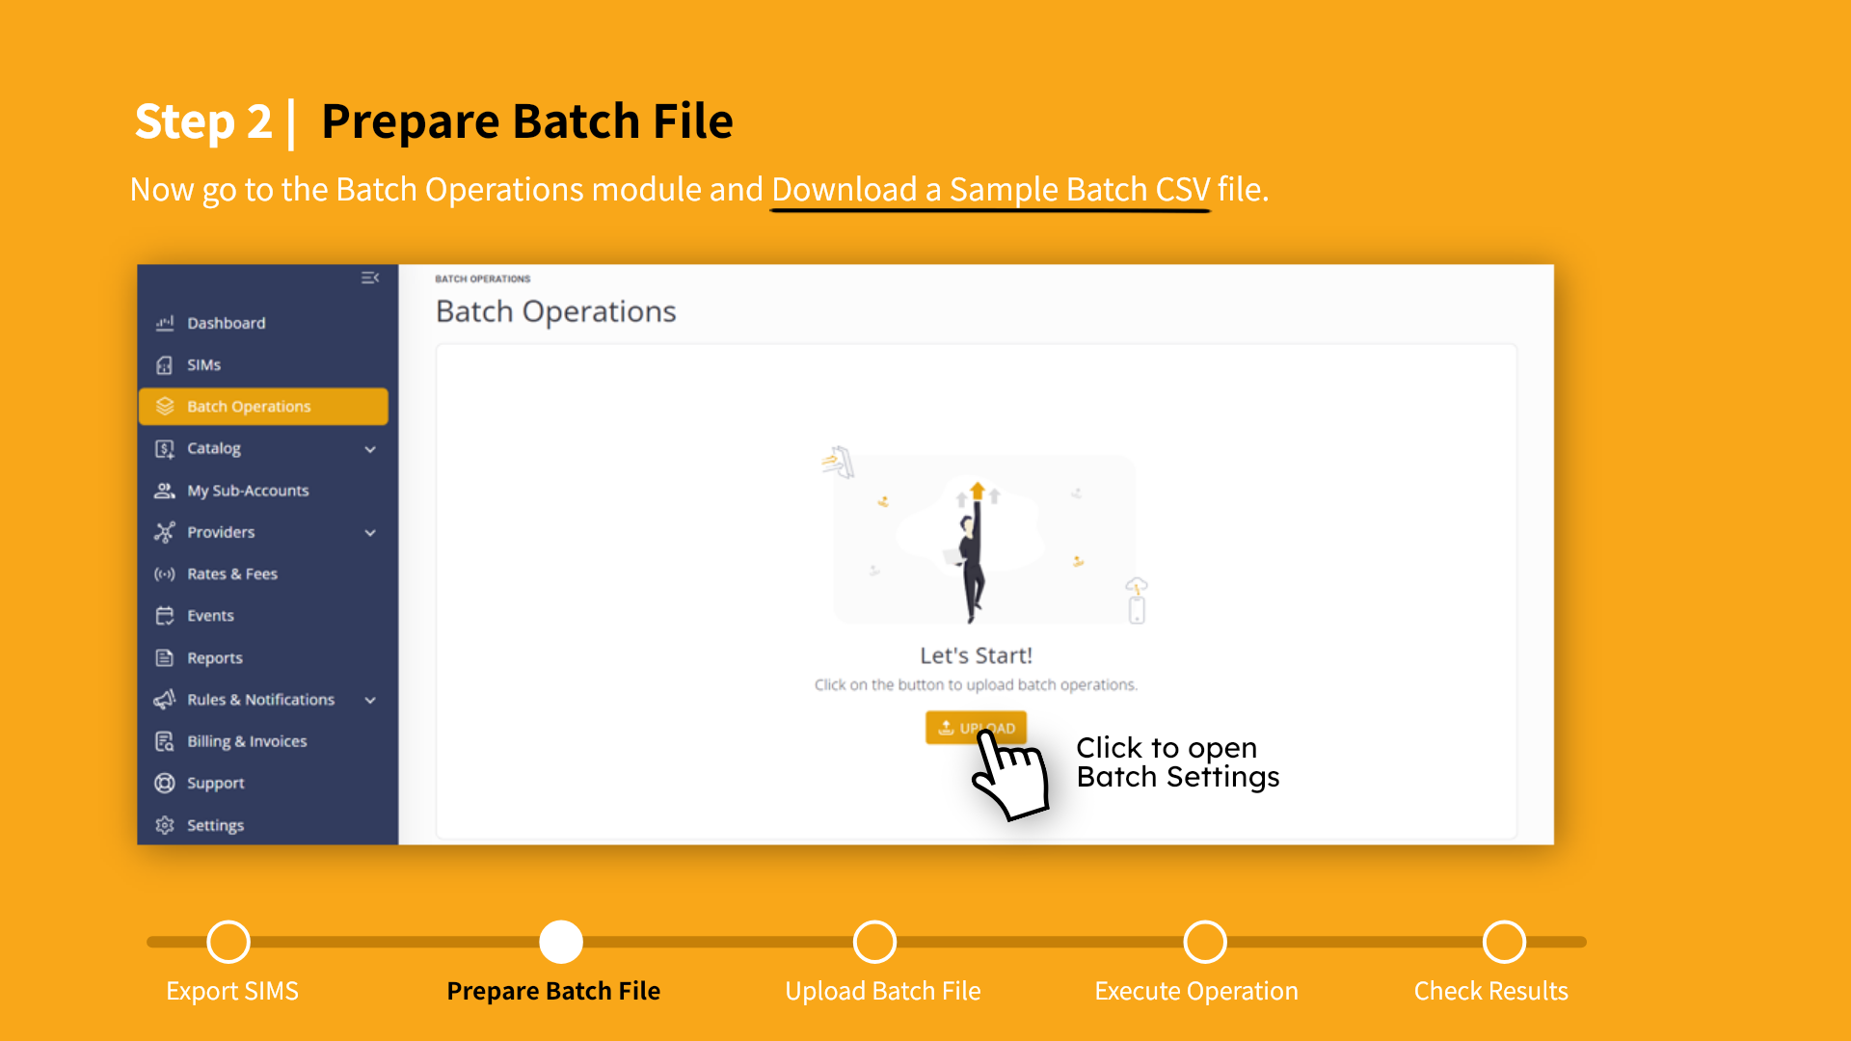
Notes:
Lets begin by navigating to the Batch Operations module. Click the Upload button to display the Upload Batch File dialog box.

Slide 11
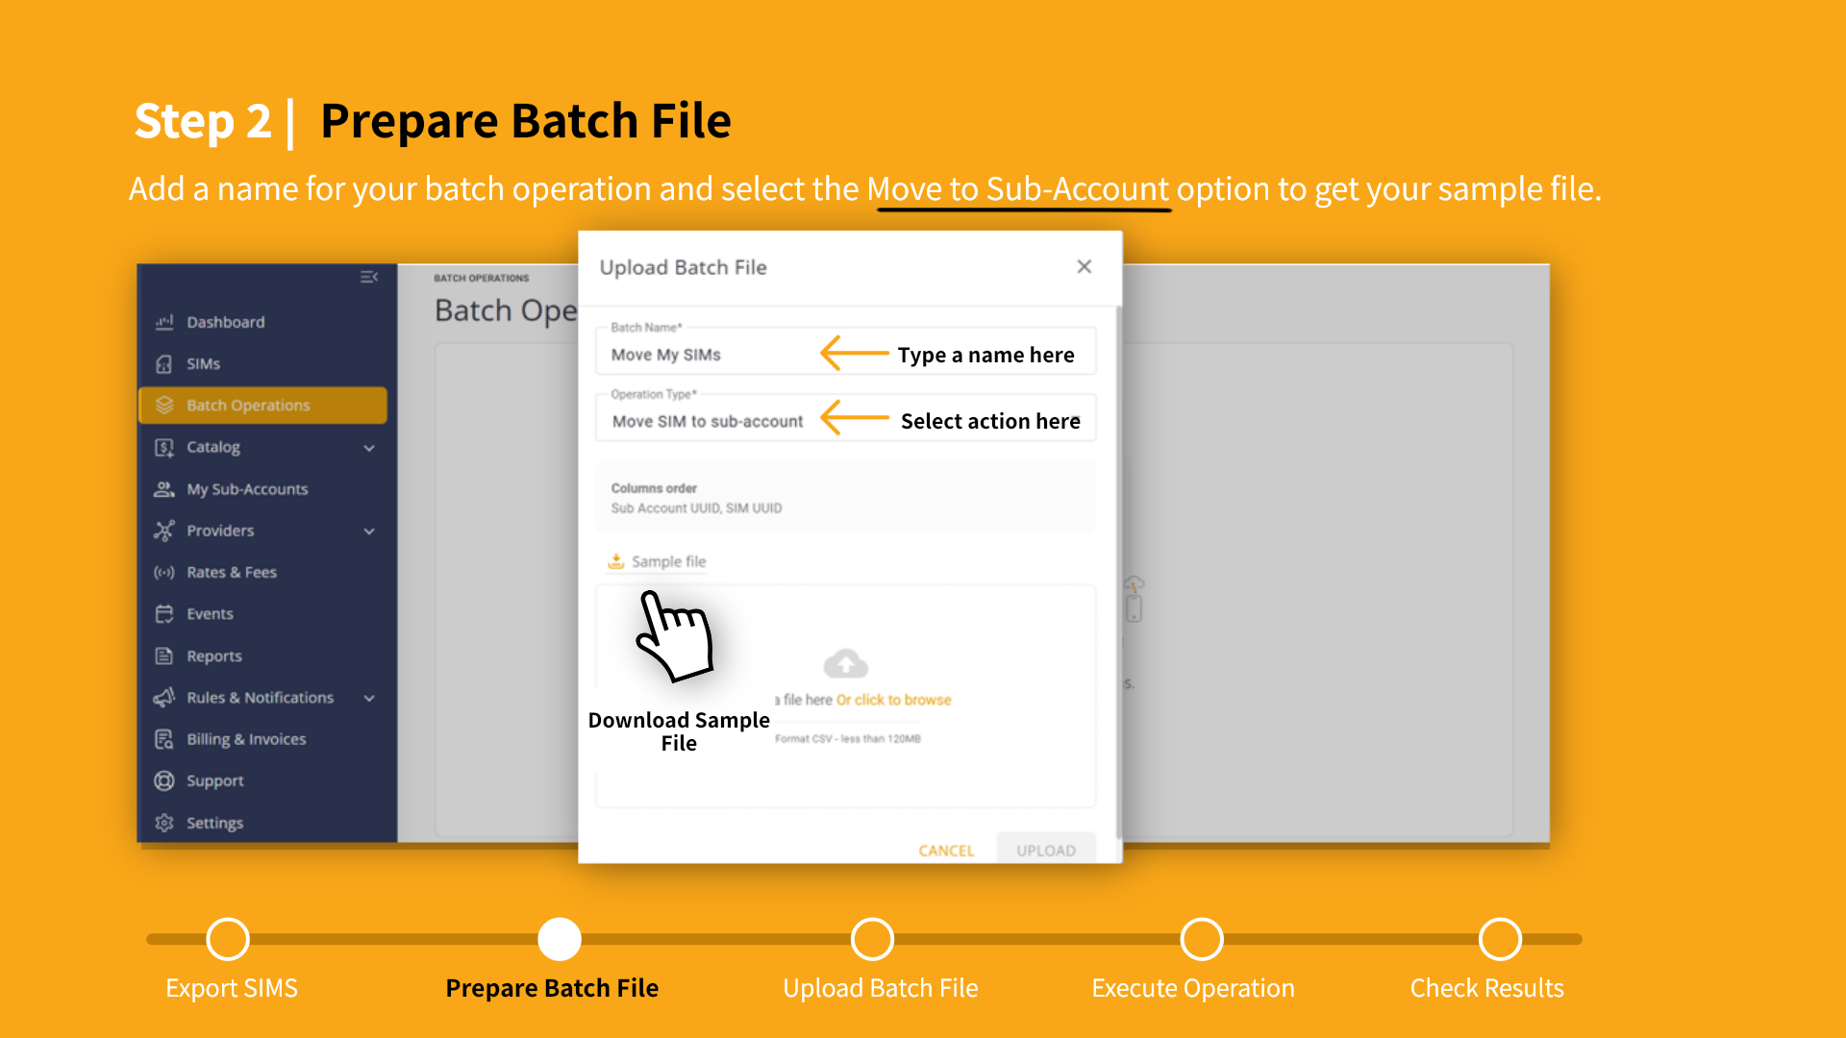
Notes:
This is where you choose the type of batch operation to run and download the appropriate Sample Batch file. First, you need to type a name that will be used to identify your batch file. . Now scroll the list of operation types and select the “Move SIM to Sub-Account” option. That's it, now you are ready to download your sample file.

Slide 12
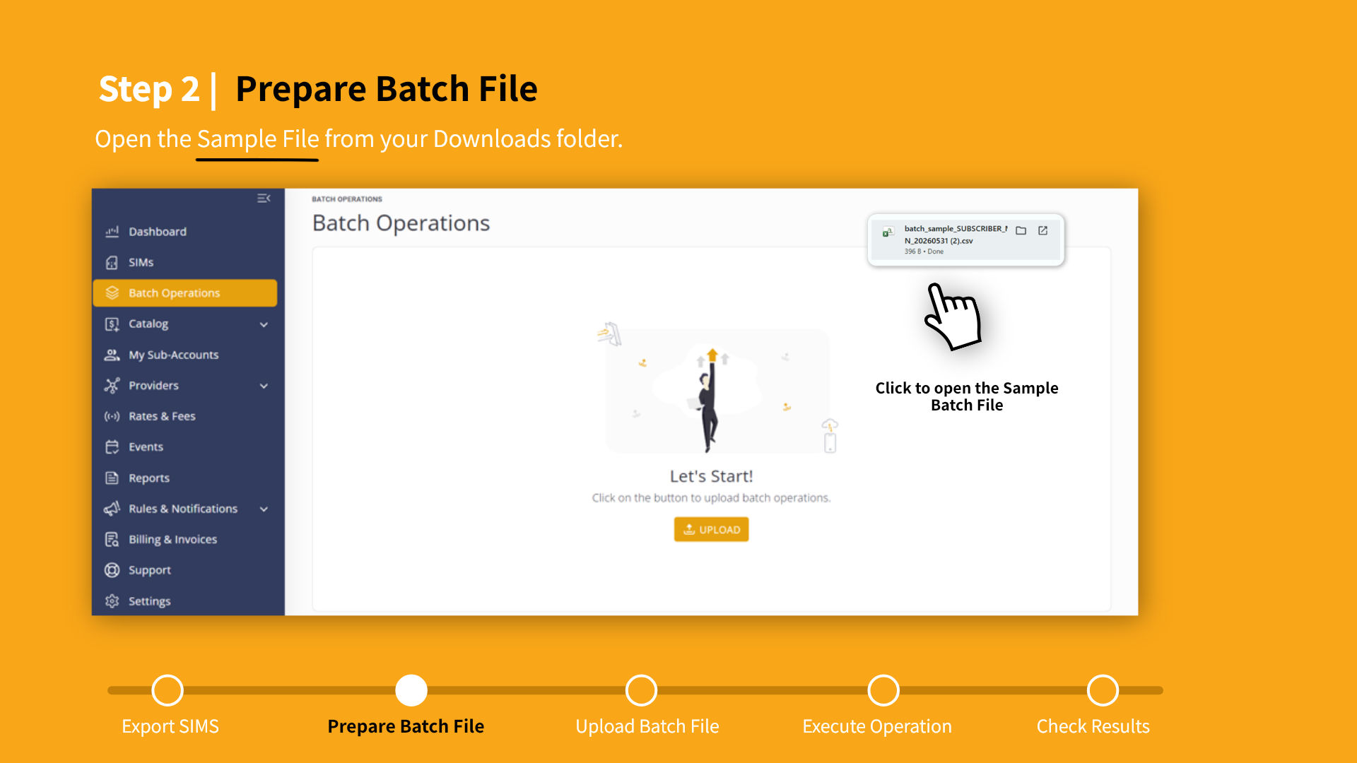
Notes:
You can open the sample batch file directly from the CMP browser. Just click the download notification box at the top of your screen

Slide 13
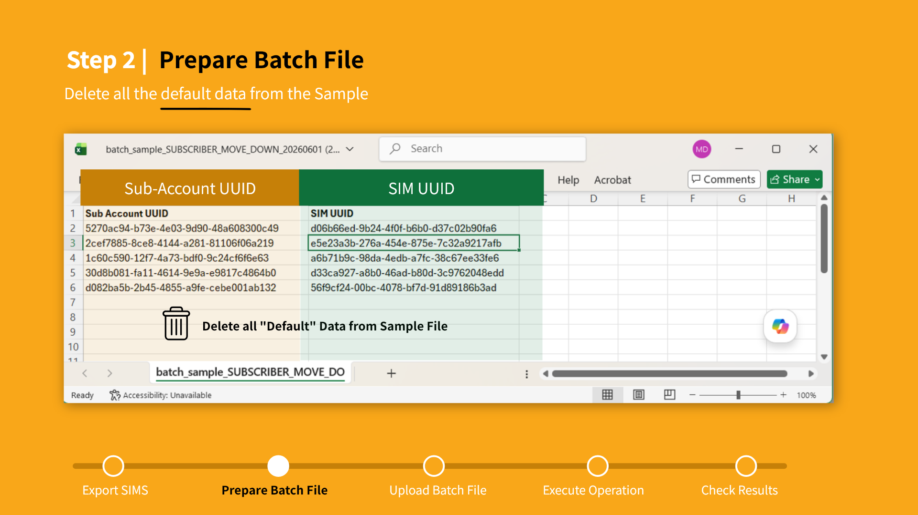
Notes:
When you open the sample batch file, you need to make sure it contains the correct column structure for processing your batch operation. Your sample file should contain the Sub-Account UUID and SIM UUID column headings. To prepare your batch file, you need to delete all the default data included in your sample file. Keep only the column headers when you save your file. This ensures no unintended data is processed.

Slide 14
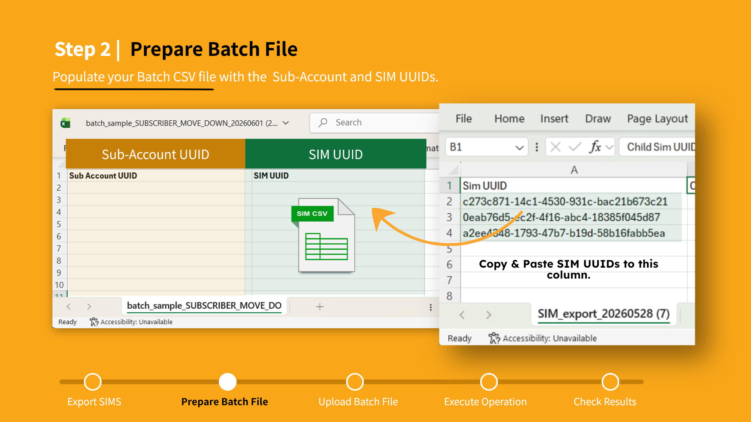
Notes:
Now you are ready to copy the SIM UUID data from the SIM CSV file into your Batch File. Make sure there are no errors when you copy-paste from one file to the other. For the next step, you need to choose a target Sub-Account for your SIMs.

Slide 15
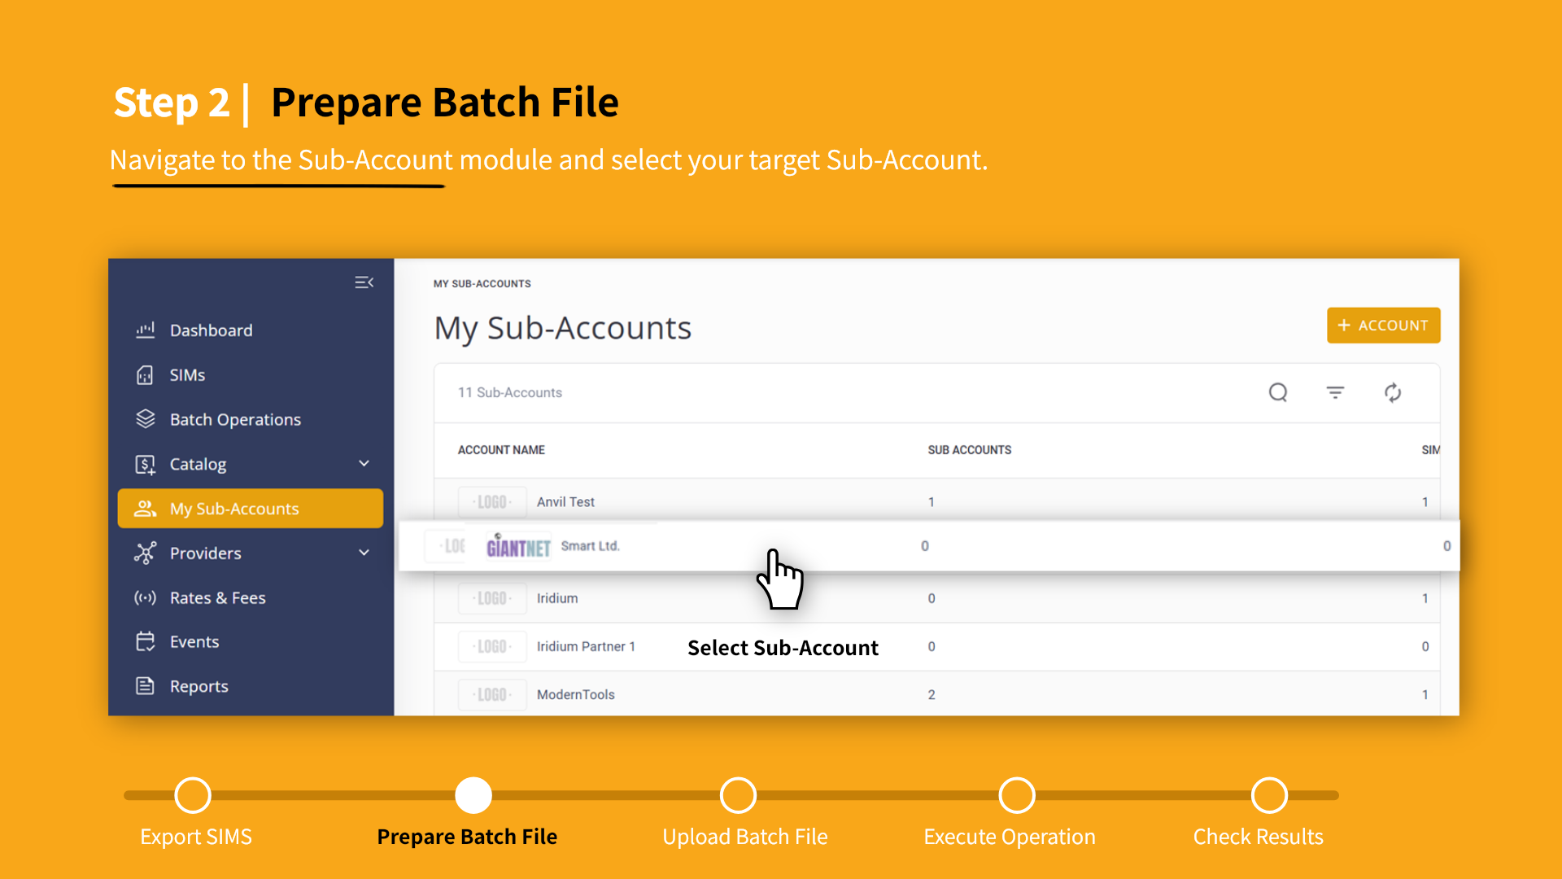
Notes:
To select your target account, navigate to the My Sub-accounts module. Then click an account to display the details page.

Slide 16
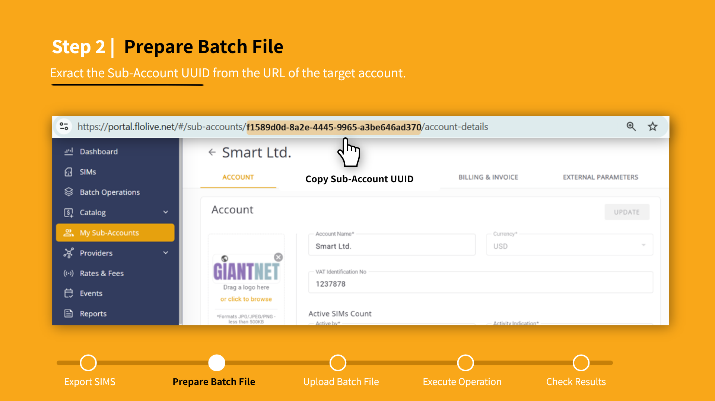
Notes:
From the Sub-Account details page you can get the identifier information you need for your batch file. Go to the URL address box and copy the Sub-Account UUID from the pathname.

Slide 17
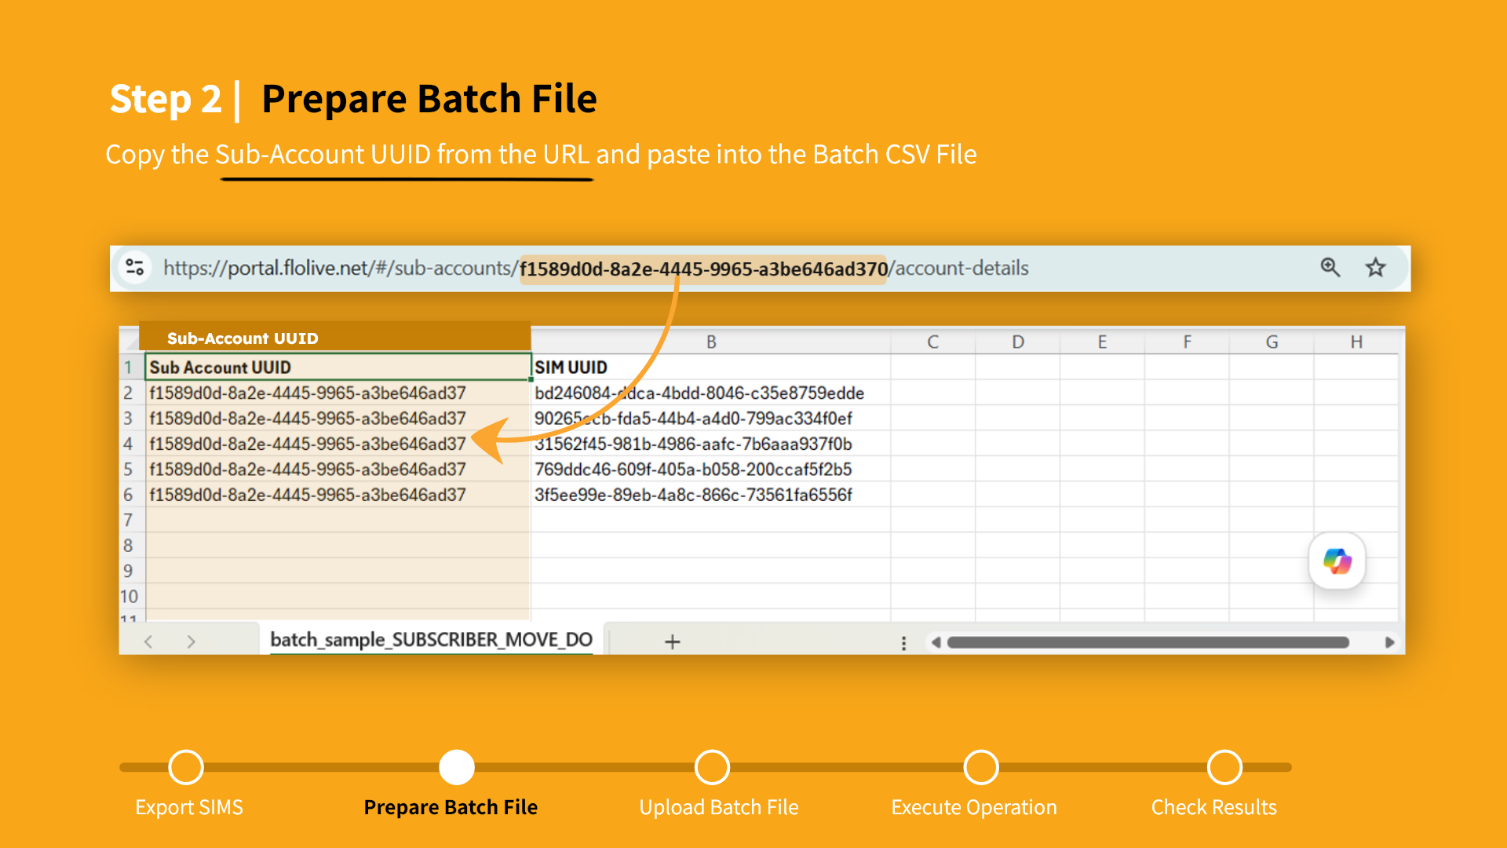
Notes:
Paste the Sub-Account UUID into your batch file. Make sure that each SIM UUID row has a corresponding Sub-Account UUID identifier

Slide 18
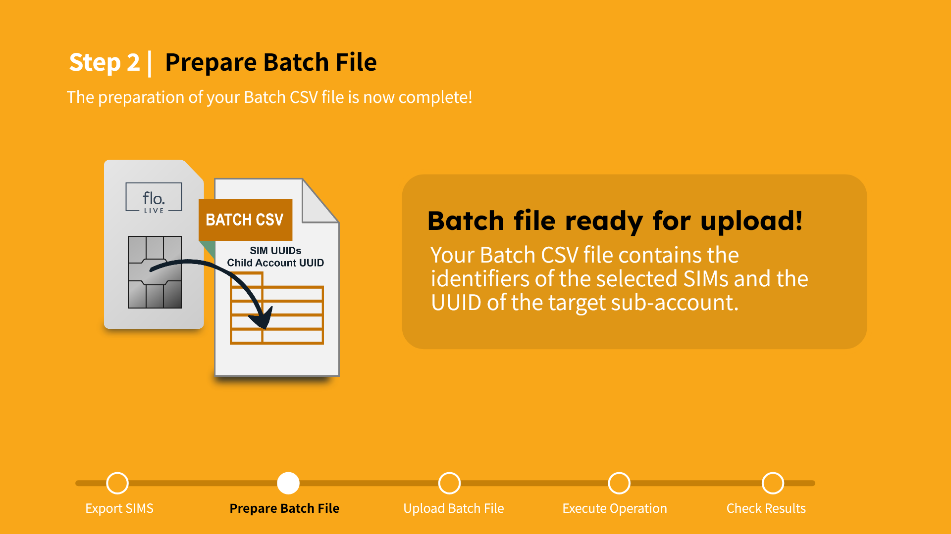
Notes:
This completes the preparation of your batch file. Your Batch CSV file contains the identifiers of the selected SIMs and the UUID of the target sub-account. You are now ready to go to the next step and upload your batch file to the CMP.

Slide 19
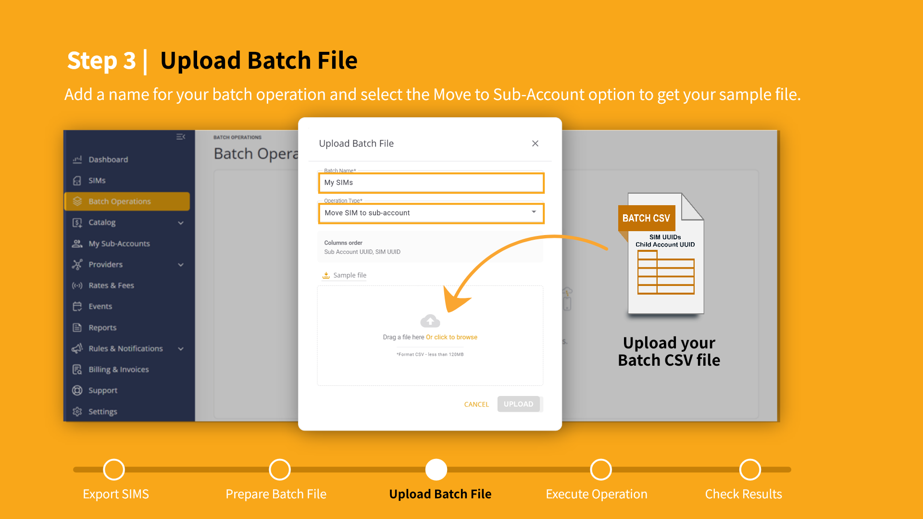
Notes:
To upload your batch CSV file, you need to enter a name for the batch operation, and then select the ‘Move to Sub-Account’ operation type. Now Drag and drop your CSV file into the specified area.

Slide 20
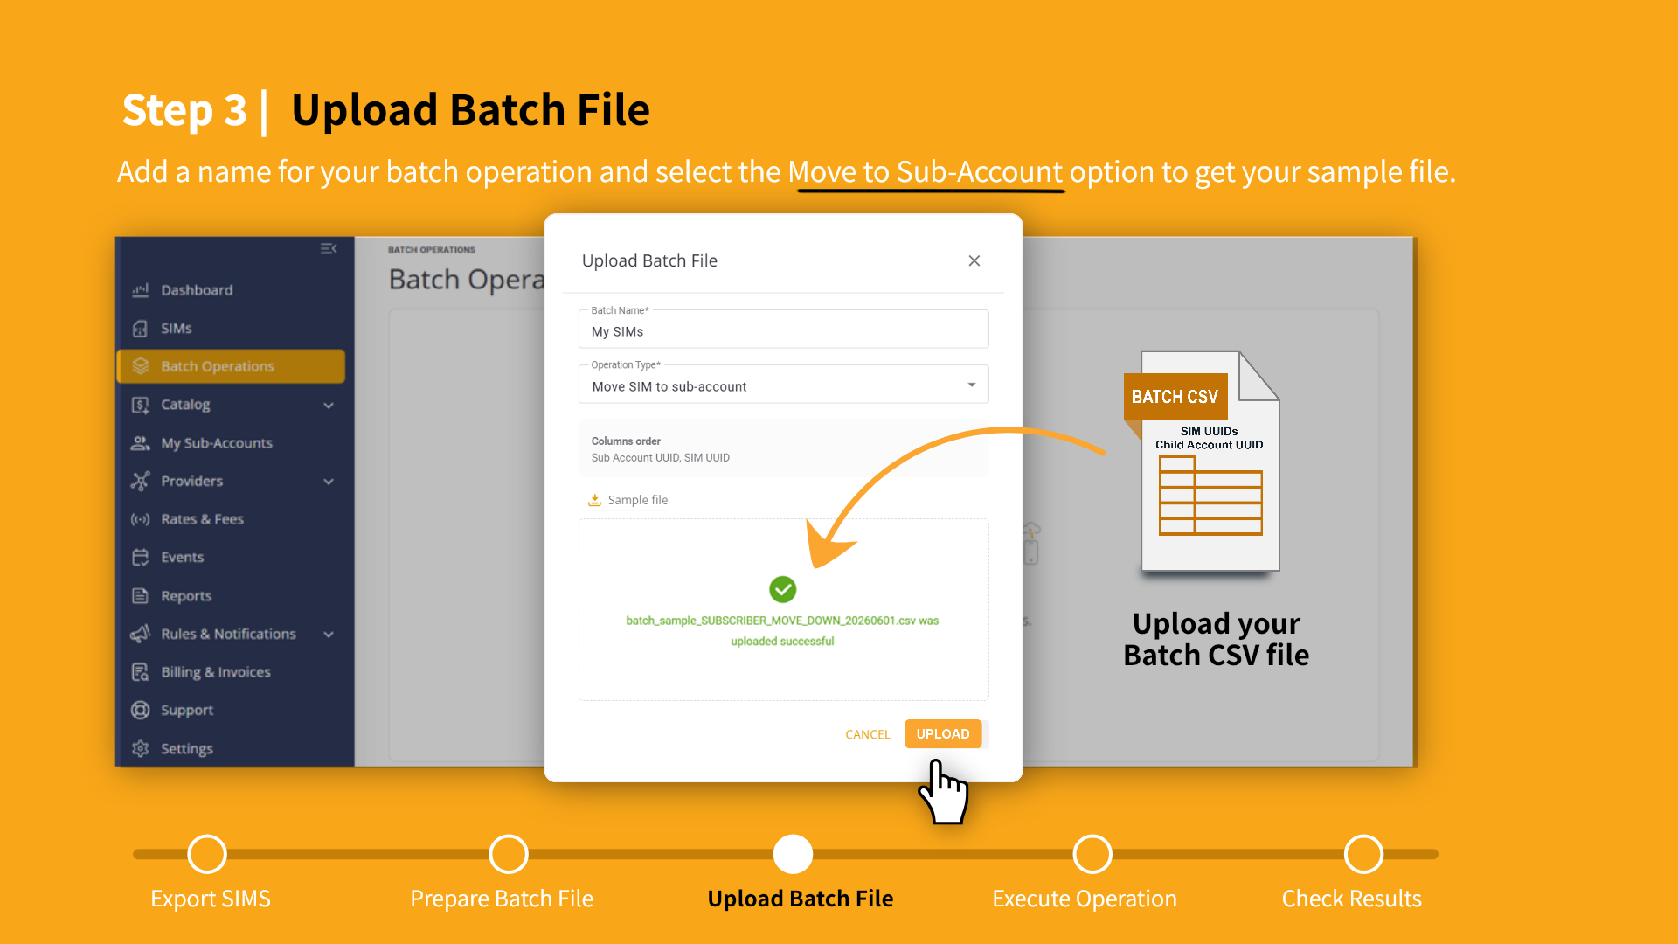
Notes:
If the CSV file is valid,you will receive a "Success" Message. Click Upload to send your file to the batch operation queue.

Slide 21
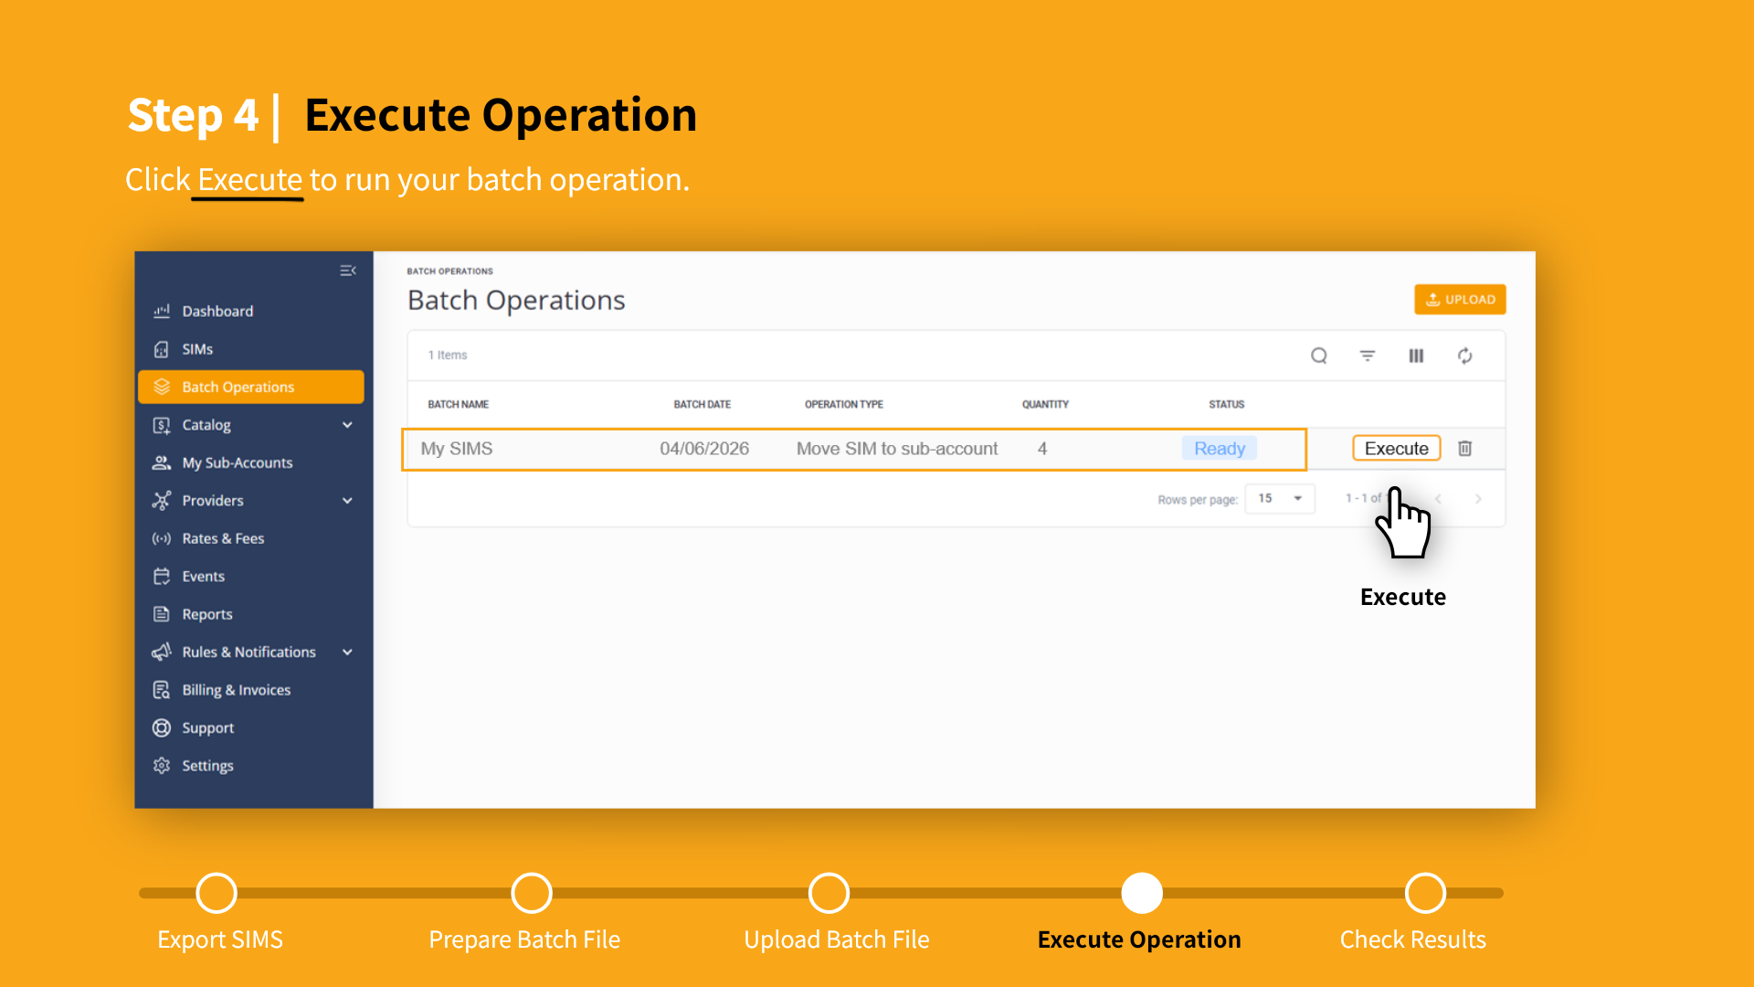
Notes:
Now select your batch operation from the list. When the batch status shows ‘Ready,’ click ‘Execute’ to begin processing.

Slide 22
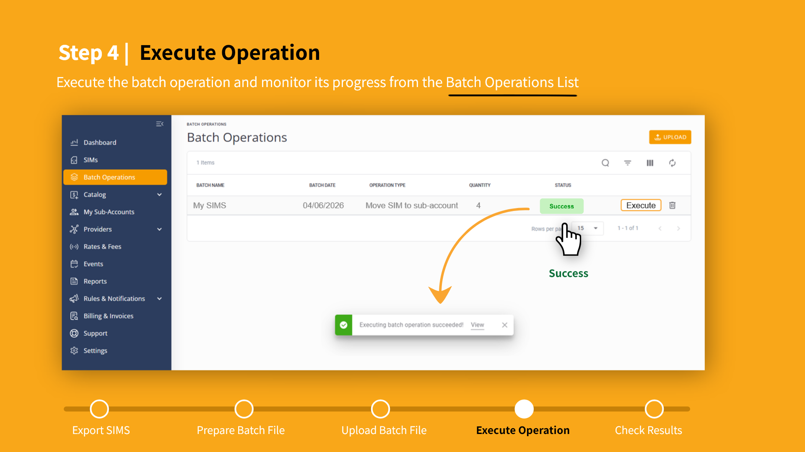
Notes:
The CMP platform runs the batch operation automatically. When the batch operation is complete, a Success message is displayed. . Now click your batch file to display the batch operation details page.

Slide 23
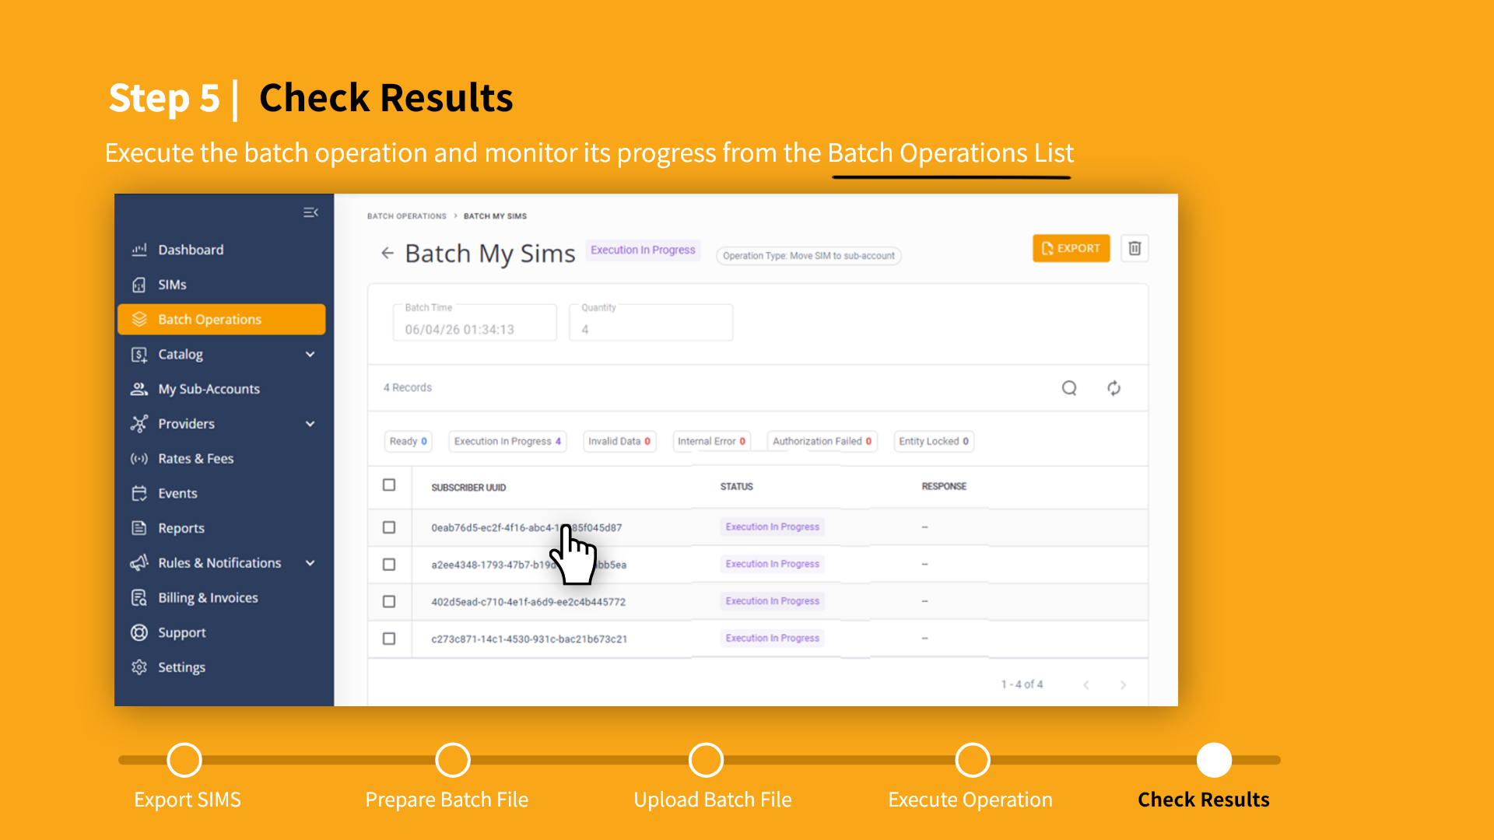
Notes:
In the batch operation details page you can monitor the progress and status of each SIM until the batch operation is complete. Here you can check the results and make sure all SIMs were moved without errors.

Slide 24
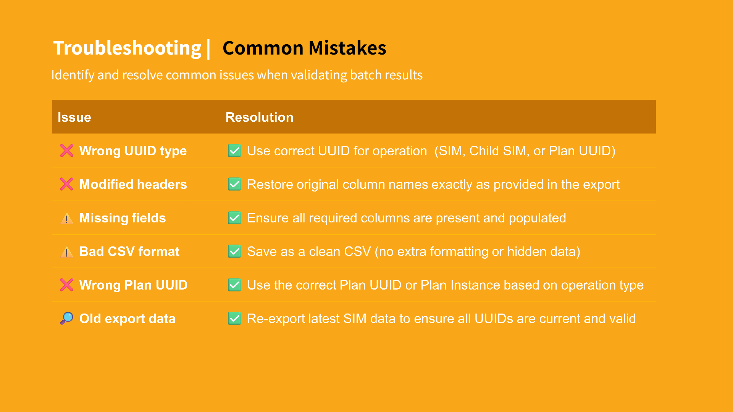
Notes:
This slide highlights common issues you may encounter when checking batch results. Reviewing these points helps quickly identify and fix issues during validation.” If the wrong UUID type is used, the operation will fail—so make sure the UUID matches the operation, such as SIM, Child SIM, or Plan.
If column headers are modified, the system may not recognize the file. Always keep the original headers exactly as exported.
Missing fields can also cause errors, so confirm all required columns are present and filled in.
File format is another common issue—ensure the file is saved as a clean CSV, without extra formatting or hidden data.
Using the wrong Plan UUID can lead to incorrect results, so verify it matches the operation type.
Finally, outdated export data can cause failures—re-export the latest SIM data to ensure all values are valid.

Slide 25
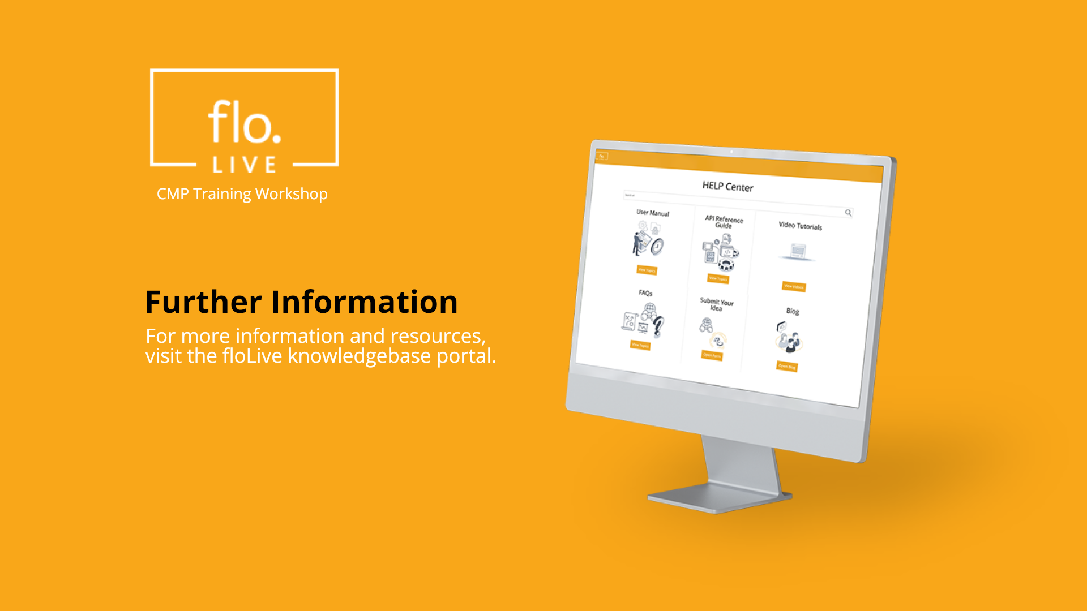
Notes:
Thank you for watching this video tutorial. For more information about the CMP system, make sure you visit our Knowledge-base that is accessible directly from the CMP Portal.

